Slide 1
We live on the Earth. It is one of the eights planets of the universe.
Life is only on our planet, isn’t it?
What do you think?
Have you ever faced with any strange situations in your life?
Is there life somewhere in the universe?
Are we the only living beings or not?

Slide 2
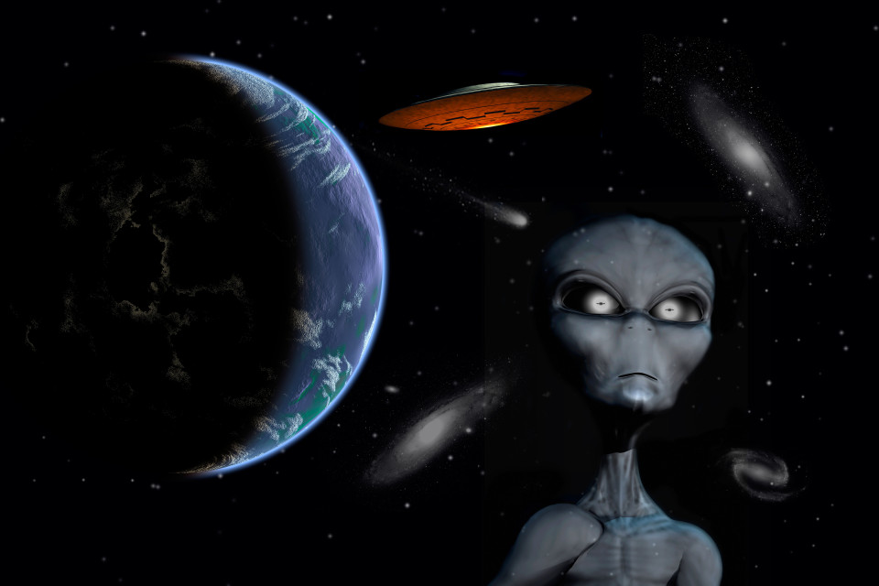
What is the theme of our lesson?
It’s the UFO tour

Slide 3
The plan of today’s lesson
Vocabulary
Listening and reading
Grammar (the Passive)

Slide 4
Useful words and phrases
Unfold (v) a) the examination of a dead body to find out the cause of death
Lined with (pp) b) strange and frightening
Weather balloon c) sb who raises cows and bulls
Cattle farmer(n) d) to develop
Hangar(n) e) uncertain
Eye-witness account (phr) f) kind of writing used in ancient Egypt
Hieroglyphics (pl n) g) the description of the event from sb who has seen sth
Autopsy (n) h) an inflatable device that records the weather changes
Doubtful (adj) i) a big building where aircraft are kept
Weird (adj) j) having sth along both sides of sth else
Eerie (adj) k) a task/project
Assignment (n) l) strange,afterworld

Slide 5
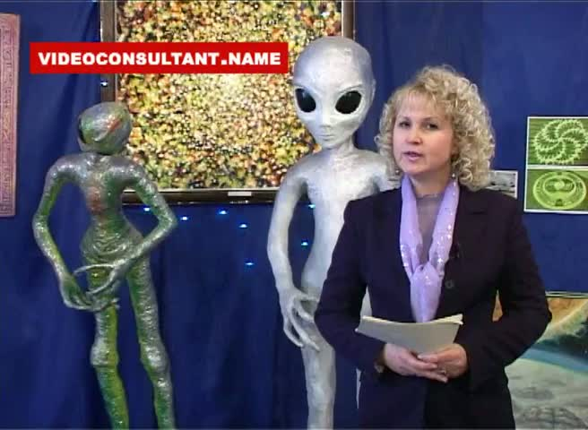

Slide 6
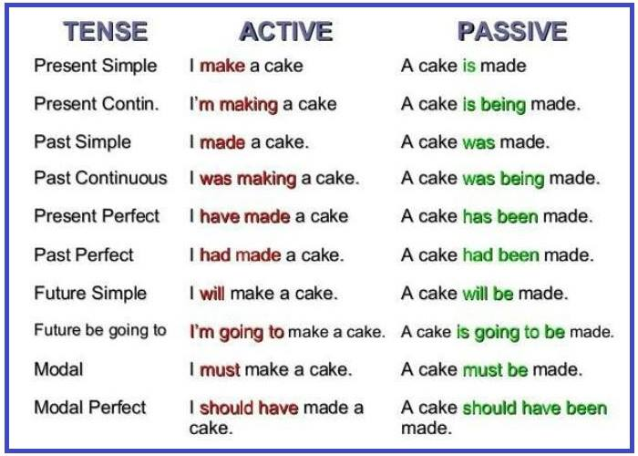

Slide 7
What did you like most in our lesson?
What has impressed you most?

Slide 8
Useful website to practice irregular verbs
http://www.irregularverbs.ru/test/53c3a4bf34b241d26ba8ee23e7c60592/

Slide 9
Home task
WB :p 46 Ex. 1-6
SB: p 69 Ex.9/ find out some facts about aliens in Russian cities or towns.

Slide 10
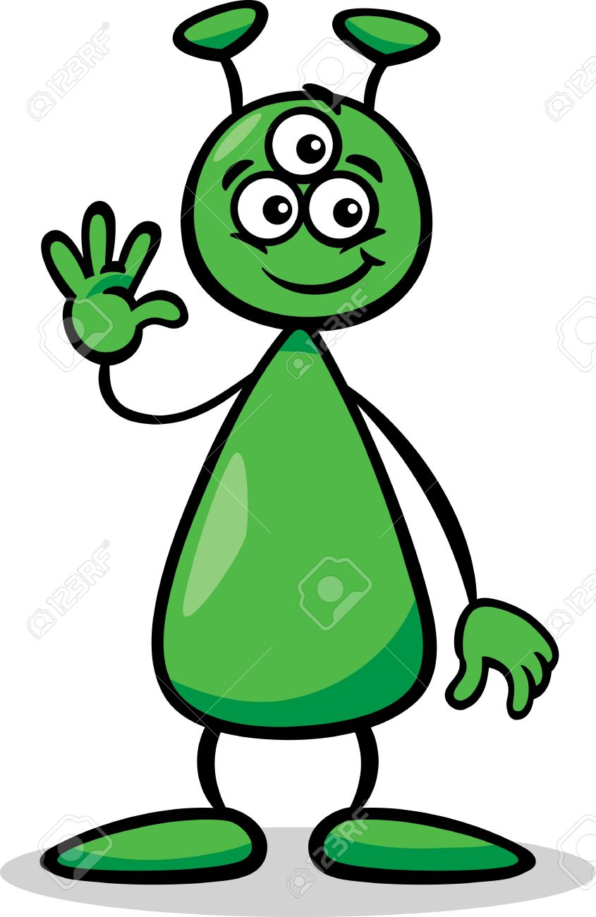
Thank you for the lesson!

