Slide 1
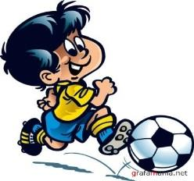
Today is the 13th of April Theme:Rules and respect

Slide 2
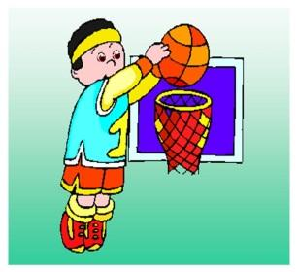

Slide 4
Read the text and answer to the questions below
Rules of Boxing
In professional boxing bouts take place over 12 three minute rounds with one minute rest between round. The only method of attack is punching with a clenched fist and you may not strike below the belt in the kidneys or the back of your opponents head or neck. You cannot use the ropes for leverage. You cannot hit an opponent when they are down . A boxer hit with a low blow can take five minutes to recover. If an unintentional foul (such as clash of heads) end the fight before four rounds are completed this is a “no contest” from the fifth onwards the decision goes to the judge’s cards and is either a technical decision for either fighter or a technical draw.

Slide 5
Answer the questions
How many rounds could be in professional boxing bouts?
How many minutes are there between rounds?
How might you strike your opponents?
When does the boxer can take five minutes rest?

Slide 6
Write true or false
3.(I) Task. Read the text. Are these sentences true or false? Corrects the false sentences.
True/False Activity
1) Kazakh boxers often win medals at the Olympics.
2) Kazakh ice hockey is the most successful sport.
3) Alexander Vinokourov won a cycling race in France
4) Men and women play rugby in Kazakhstan.
5) The Kazakh women’s rugby term is very successful
Descriptors

