Slide 1
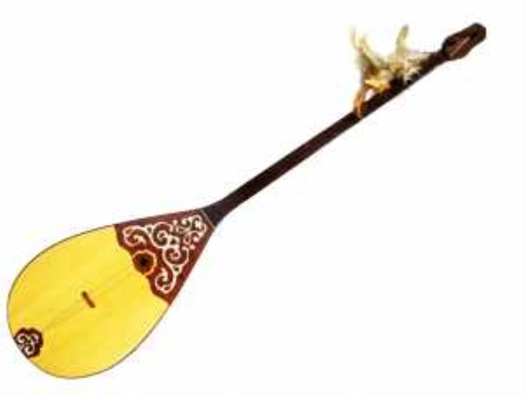
Strategy: Who knows?
Presentation new theme the legend about dombra «The two giants » by asking questions:
- How do you think what musical instrument is it?
-What does it look like?
-What do you know about dombra?

Slide 2
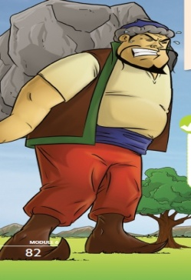
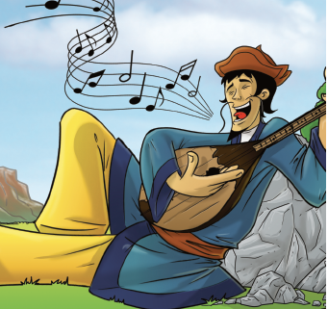
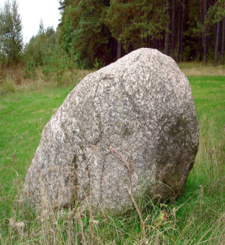
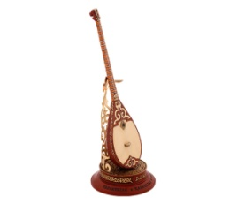
Theme of the lesson:
The Two Giants

Slide 3
Lesson objectives :
-to understand the main event of the story;
-to develop speaking, reading abilities;
-to use linkers join in speaking.
Assessment criteria:
-uses the words with support
-uses and explains the words without support
-prepares and compares the lexical material with support
-prepares, compares and explains the lexical materials without support

Slide 4
Pre-reading task: By Quizlet
The quick vocabulary
Show and listen new words
from the story
/Watching/
Strategy video promt:
The two giants

Slide 5
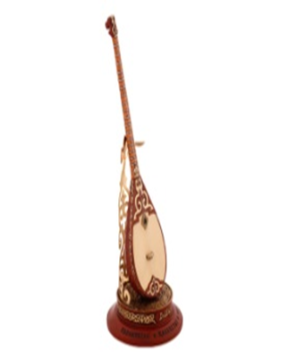
Surprised from the box
Every fire has got a task. The pupils
must read and give the translations
and opinions.
Descriptor:
A learner
-Reads correctly
-Translate
- Gives opiniouns
Read and complete

Slide 6
Strategy: Cinquain
Presentation of the heroes.
Make up a presentation about the positive and negative qualities of the hero and present this hero to the class.
The first sentence-noun
The second sentence-two adjectives
The third sentence-three verbs
The fourth sentence- one sentence (The clause must be complemented by a single idea)
The fifth sentence-Synonym of the first sentence
/writing/

Slide 7
Strategy: Cinquain
Descriptor:
-correctly writing of the words
-right grammatically structure of the sentence
-correctly reading the words and the sentence

Slide 8
Venn diagram
“Two brothers”
Older brother
Younger brother
Both

Slide 9
Reflection:
/Dombra/
At the end of the lesson learners reflect on
What they have learned?
What remained unclear for the them?
What they continue working on ?
A learner is asked to give each other the rope by making spider web according to the lesson

Slide 10
Homework
Ex 7 p.83 b)
Join the sentences using the linkers in brackets

Slide 11
Thank you for you attention

