Slide 1
Theme: Fruits
Grade: 1

Slide 2
Objectives of the lesson.
1.S1 make basic personal about people,objects and classrooms routines
1.L4 recognize with support short basic questions about what something is
1.S3 pronounce familiar words and expressions intelligibly

Slide 3
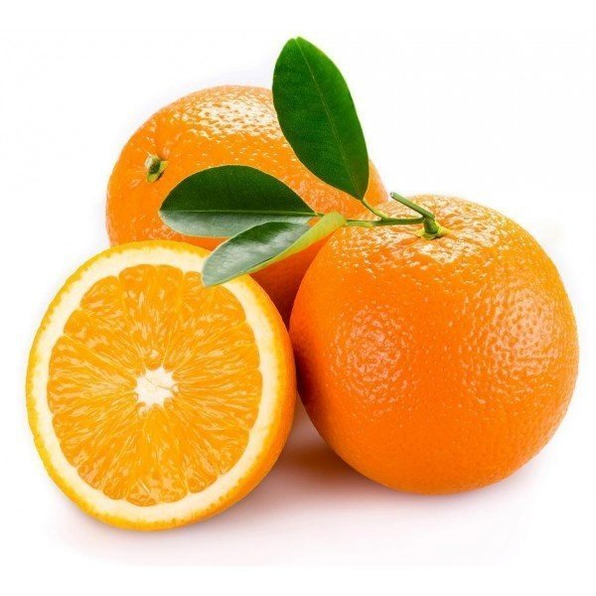
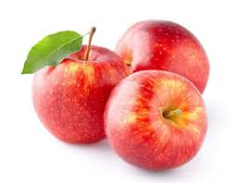
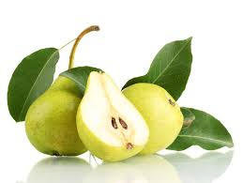
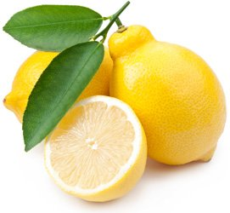
New words. Things I like.
Oranges bananas apples pears lemons

Slide 4
https://bilimland.kz/ru/courses/english-language/core-curriculum-for-english/year-3/lesson/031-fruit

Slide 5
https: //bilimland.kz/ru/courses/english-language/core-curriculum-for-english/year-3/lesson/032-do-you-like-oranges

Slide 6
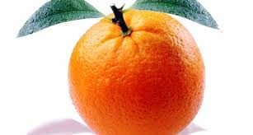
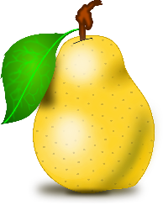
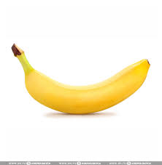
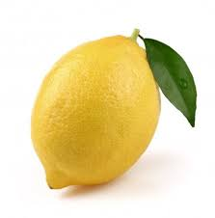
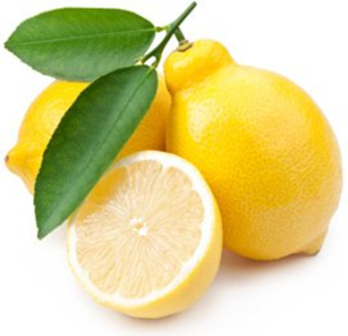
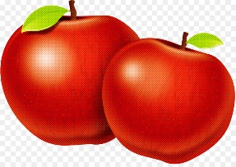
Singular-Plural forms.
Orange-oranges
Pear-pears
Banana-bananas
Lemon-lemons
Apple-apples

Slide 7
https://bilimland.kz/ru/courses/english-language/core-curriculum-for-english/year-3/lesson/031-fruit

Slide 8
Lemons pears apples bananas oranges
match

Slide 9
Lemons pears apples bananas oranges
match

Slide 11
Home task: Write new words in your copy book and learn,colour the picture.

